Slide 1
A Regression Problem
y = f(x) + noise
Can we learn f from this data?
Let’s consider three methods…
y
x

Slide 2
Linear Regression
y
x

Slide 3
Quadratic Regression
y
x

Slide 4
Join-the-dots
Also known as piecewise linear nonparametric regression if that makes you feel better
y
x

Slide 5
Which is best?
y
y
x
x
Why not choose the method with the best fit to the data?

Slide 6
What do we really want?
y
y
x
x
Why not choose the method with the best fit to the data?
“How well are you going to predict future data drawn from the same distribution?”

Slide 7
The test set method
1. Randomly choose 30% of the data to be in a test set
2. The remainder is a training set
y
x

Slide 8
The test set method
1. Randomly choose 30% of the data to be in a test set
2. The remainder is a training set
3. Perform your regression on the training set
y
x
(Linear regression example)

Slide 9
The test set method
1. Randomly choose 30% of the data to be in a test set
2. The remainder is a training set
3. Perform your regression on the training set
4. Estimate your future performance with the test set
y
x
(Linear regression example)
Mean Squared Error = 2.4

Slide 10
The test set method
1. Randomly choose 30% of the data to be in a test set
2. The remainder is a training set
3. Perform your regression on the training set
4. Estimate your future performance with the test set
y
x
(Quadratic regression example)
Mean Squared Error = 0.9

Slide 11
The test set method
1. Randomly choose 30% of the data to be in a test set
2. The remainder is a training set
3. Perform your regression on the training set
4. Estimate your future performance with the test set
y
x
(Join the dots example)
Mean Squared Error = 2.2

Slide 12
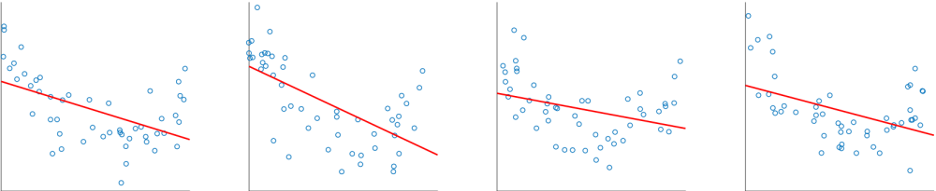
Bias
Regardless of training sample, or size of training sample, model will produce consistent errors
Notes:
[*] underpredicts at the ends; overpredicts at the center

Slide 13
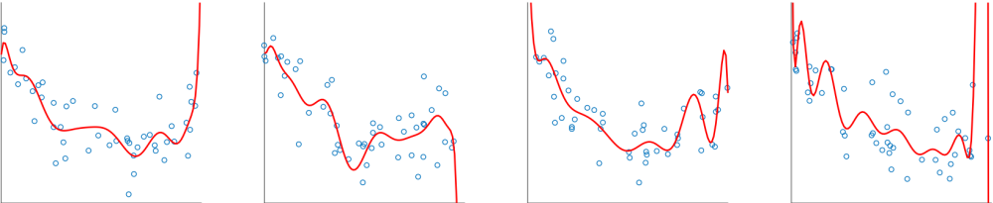
Variance
Different samples of training data yield different model fits

Slide 14
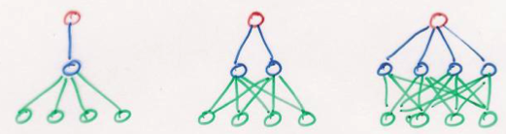
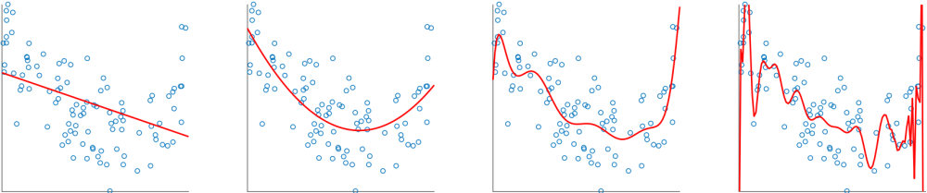
Restricting Models
Models range in their flexibility to fit arbitrary data
simple model
complex model
Notes:
constrained : unconstrained :: parametric : nonparametric

Slide 15


BIAS
WHAT IS BIAS?
Bias is a phenomenon that skews the result of an algorithm in favor or against an idea. In the simplest terms, Bias means training error. Bias is a systematic error that occurs due to wrong assumptions in the machine learning process.
Let y be the true value of a parameter, and let ŷ be an estimator of based on a sample of data. Then, the bias of the estimator is given by:
Bias(ŷ) = E(ŷ) - y
where E(ŷ) is the expected value of the estimator .

Slide 16


BIAS
LOW BIAS
It means training error is low. Examples of low-bias machine learning algorithms include: Decision trees, k-Nearest Neighbors and SVM.
HIGH BIAS
It means training error is high. Examples of high-bias machine learning algorithms include: Linear regression, Linear
Discriminant Analysis and Logistic Regression.

Slide 17

VARIANCE
WHAT IS VARIANCE?
Variance refers to the changes in the model when using different portions of the training data set. Simply stated, Variance means testing error.
Let y be the actual values of the target variable, and ŷ be the predicted values of the target variable. Then the variance of a model can be measured as the expected value of the square of the difference between predicted values and the expected value of the predicted values.
Variance = E [( ŷ - E[ŷ] )^2 ]
where E(ŷ) is the expected value of the predicted values.
6

Slide 18
VARIANCE
LOW VARIANCE
It means testing error is low. Examples of low-variance machine learning algorithms include: Linear Regression, Linear Discriminant Analysis and Logistic Regression.
HIGH VARIANCE
It means testing error is high. Examples of high-variance machine learning algorithms include: Decision Trees, k- Nearest Neighbors and Support Vector Machines.

Slide 19





RELATIONSHIP BETWEEN BIAS AND VARIANCE
Low Variance
High Variance
Low Bias
High Bias

Slide 20
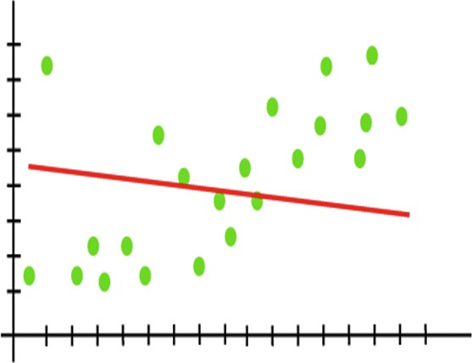
UNDERFITTING
A statistical model or a machine learning algorithm is said to have underfitting when a model is too simple to capture data complexities.

Slide 21
UNDERFITTING
It represents the inability of the model to learn the training data effectively result in poor performance both on the training and testing data.
The underfitting model has High bias and low variance.

Slide 22



REASONS FOR UNDERFITTING
The model is too simple, So it may be not capable to represent
the complexities in the data.
The input features which is used to train the model is not the adequate representations of underlying factors influencing the target variable.
The size of the training dataset used is not enough.

Slide 23
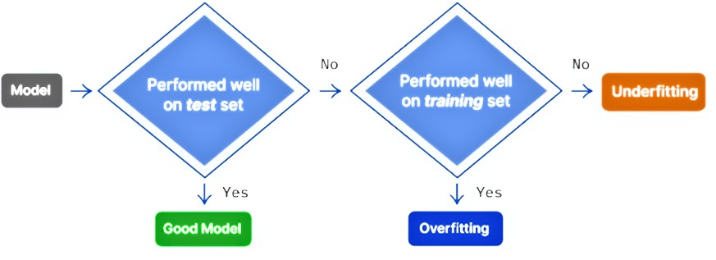
REASONS FOR UNDERFITTING
Excessive regularization are used to prevent the underfitting, which constraint the model to capture the data well.
Features are not scaled.

Slide 24


TECHNIQUES TO REDUCE UNDERFITTING
Increase model complexity.
Increase the number of features, performing feature engineering. Remove noise from the data.
Increase the number of epochs or increase the duration of training to get better results.

Slide 25


TECHNIQUES TO REDUCE UNDERFITTING
In order to overcome underfitting we have to model the expected
value of target variable as nth degree polynomial yielding the general Polynomial.The training error will tend to decrease as we increase the degree d of the polynomial. Mathematical representation is given below:

Slide 26

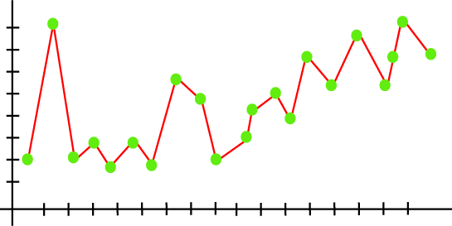
OVERFITTING
Overfitting occurs when our machine learning model tries to cover all the data points or more than the required data points present in the given dataset.
Because of this, the model starts caching noise and inaccurate values present in the dataset, and all these factors reduce the efficiency and accuracy of the model.

Slide 27
OVERFITTING
The overfitted model has low bias
and high variance.
Overfitting is the main problem that occurs in supervised learning.

Slide 28


HOW TO DETECT OVERFITTED MODELS?
K-fold cross-validation is one of the most popular techniques commonly used to detect overfitting.
We split the data points into k equally sized subsets in K-folds cross-validation, called "folds." One split subsets act as the testing set, and the remaining folds will train the model.
The model is trained on a limited sample to estimate how the model is expected to perform in general when used to make predictions on data not used during the training of the model. One fold acts as a validation set in each turn.

Slide 29

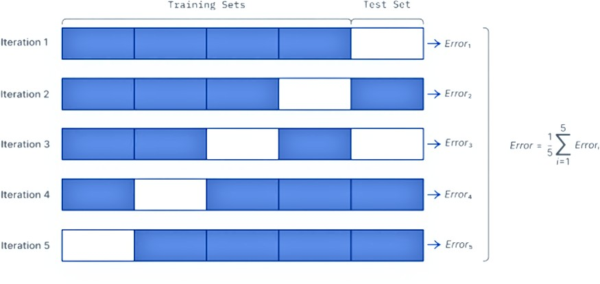
HOW TO DETECT OVERFITTED MODELS?
After all the iterations, we average the scores to assess the performance of the overall model.
K-fold cross validation

Slide 30
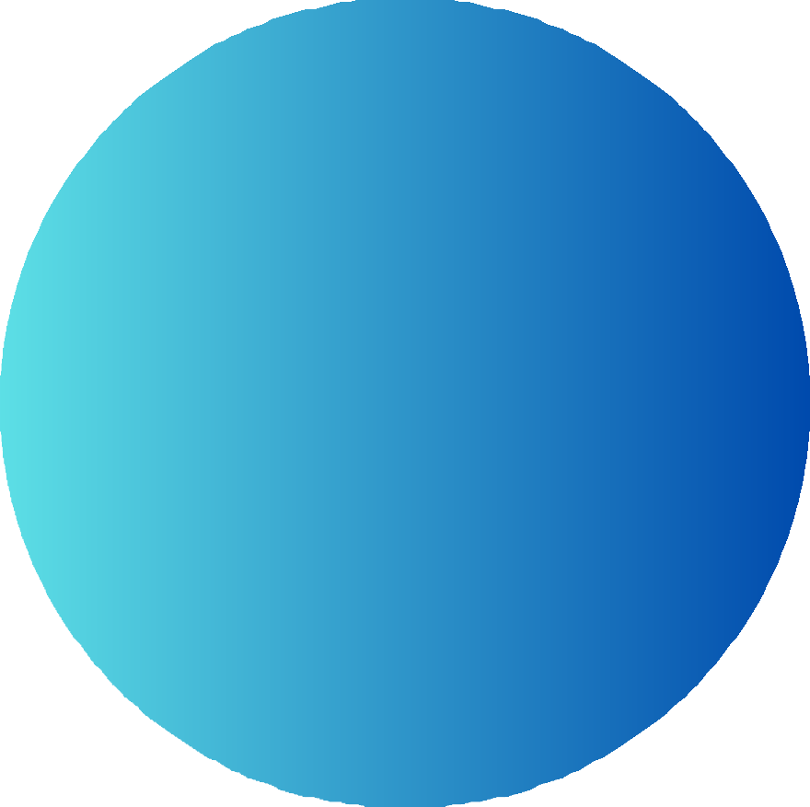
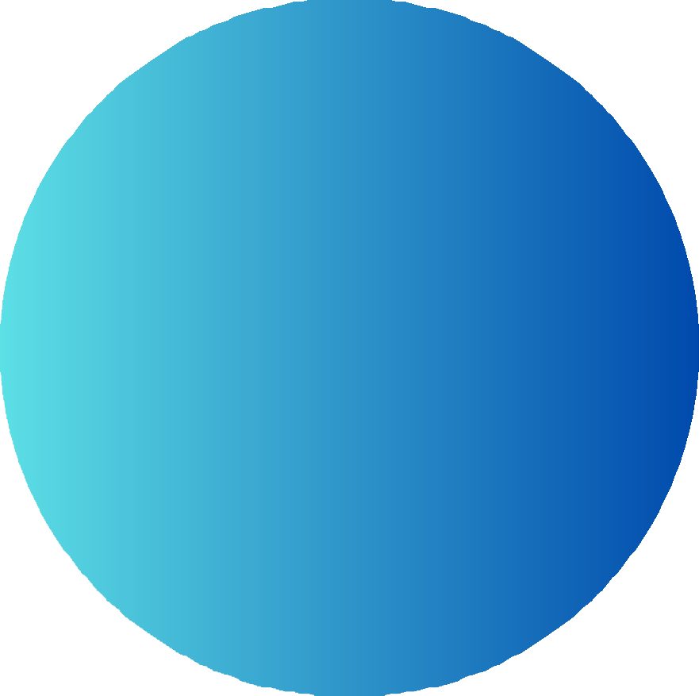
REASONS FOR OVERFITTING
High variance and low bias
Model is too complex.
Size of Training data

Slide 31

TECHNIQUES TO REDUCE OVERFITTING
Increase training data.
Reduce model complexity.
Early stopping during the training phase (have an eye over the loss
over the training period as soon as loss begins to increase stop training).
Ridge Regularization and Lasso Regularization.
Use dropout for neural networks to tackle overfitting.

Slide 32
BIAS AND VARIANCE
We try to optimize the value of the total error for the model by using the Bias variance Tradeoff.

Slide 33
BIAS-VARIANCE TRADEOFF
If the algorithm is too simple (hypothesis with linear equation) then it may be on high bias and low variance condition and thus is error-prone.
If algorithms fit too complex (hypothesis with high degree equation) then it may be on high variance and low bias.
In the latter condition, the new entries will not perform well. Well, there is something between both of these conditions, known as a Trade-off or Bias Variance Trade-off. This tradeoff in complexity is why there is a tradeoff between bias and variance. An algorithm can’t be more complex and less complex at the same time. For the graph, the perfect tradeoff will be like this.

Slide 34
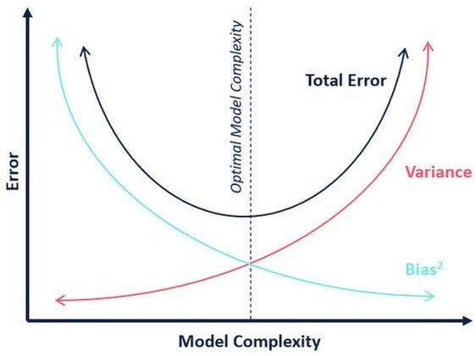
BIAS-VARIANCE TRADEOFF
Y
X

Slide 35
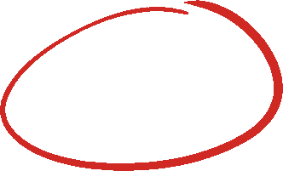
BIAS-VARIANCE TRADEOFF
Y
This is referred to as the best point chosen for the training of the algorithm which gives low error in training as well as testing data.
X

Slide 36


TECHNIQUES TO HAVE BETTER BIAS-VARIANCE TRADEOFF
1 2 3 4
GOOD MODEL DIMENTIONALITY ENSEMBLE
SELECTION REDUCTION METHODS ^{REGULARIZATION}

Slide 37
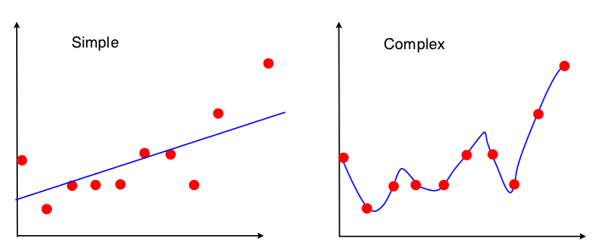
Bias and Variance
e.g. a linear model can only fit a straight line. A high-degree polynomial can fit a complex curve.
But the polynomial can fit the individual sample, rather than the population.
Its shape can vary from sample to sample, so it has high variance.

Slide 38
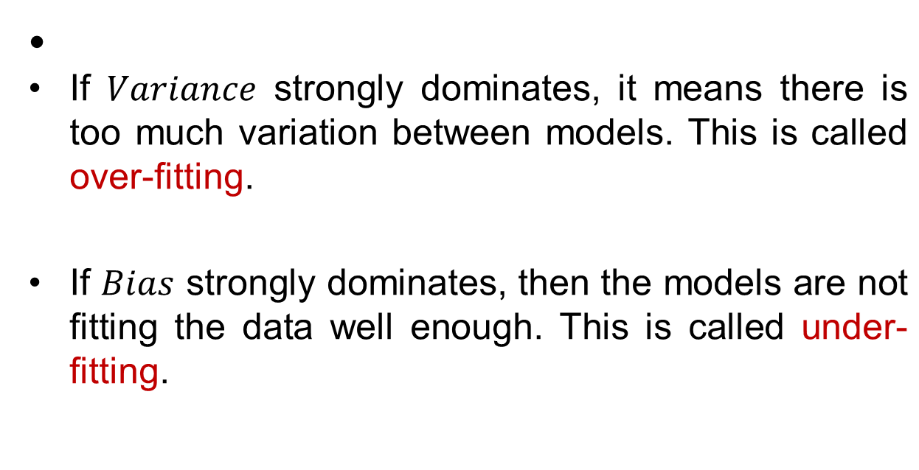
Bias and Variance

Slide 39
Overfitting
When learning a model we have a set of data (training set) that we use to learn the model parameters
The evaluation of the model needs to happen out-of-sample, i.e., on a different set that was not used for learning model parameters
One of the most common problems during training is tying the model to the training set

Slide 40
Overfitting
When a model is over fitted it is not expected to perform well to new data
  It is not generalizable
Overfitting occurs when the model chosen is too complex that ends up describing the noise in the data instead of the trend
  E.g., too many parameters relative to the size of the training dataset
  An over fitted model memorizes the training instances and does not learn the general trend in them

Slide 41
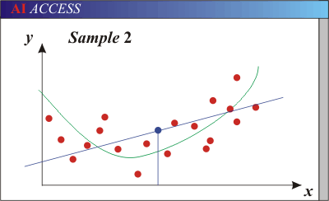
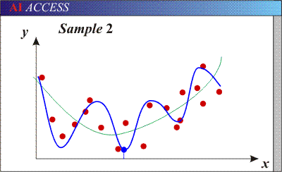
Bias-Variance Trade-off
Models with too few parameters are inaccurate because of a large bias (not enough flexibility).
Models with too many parameters are inaccurate because of a large variance (too much sensitivity to the sample).
Slide credit: D. Hoiem
Notes:
http://www.aiaccess.net/English/Glossaries/GlosMod/e_gm_bias_variance.htm

